Slide 1
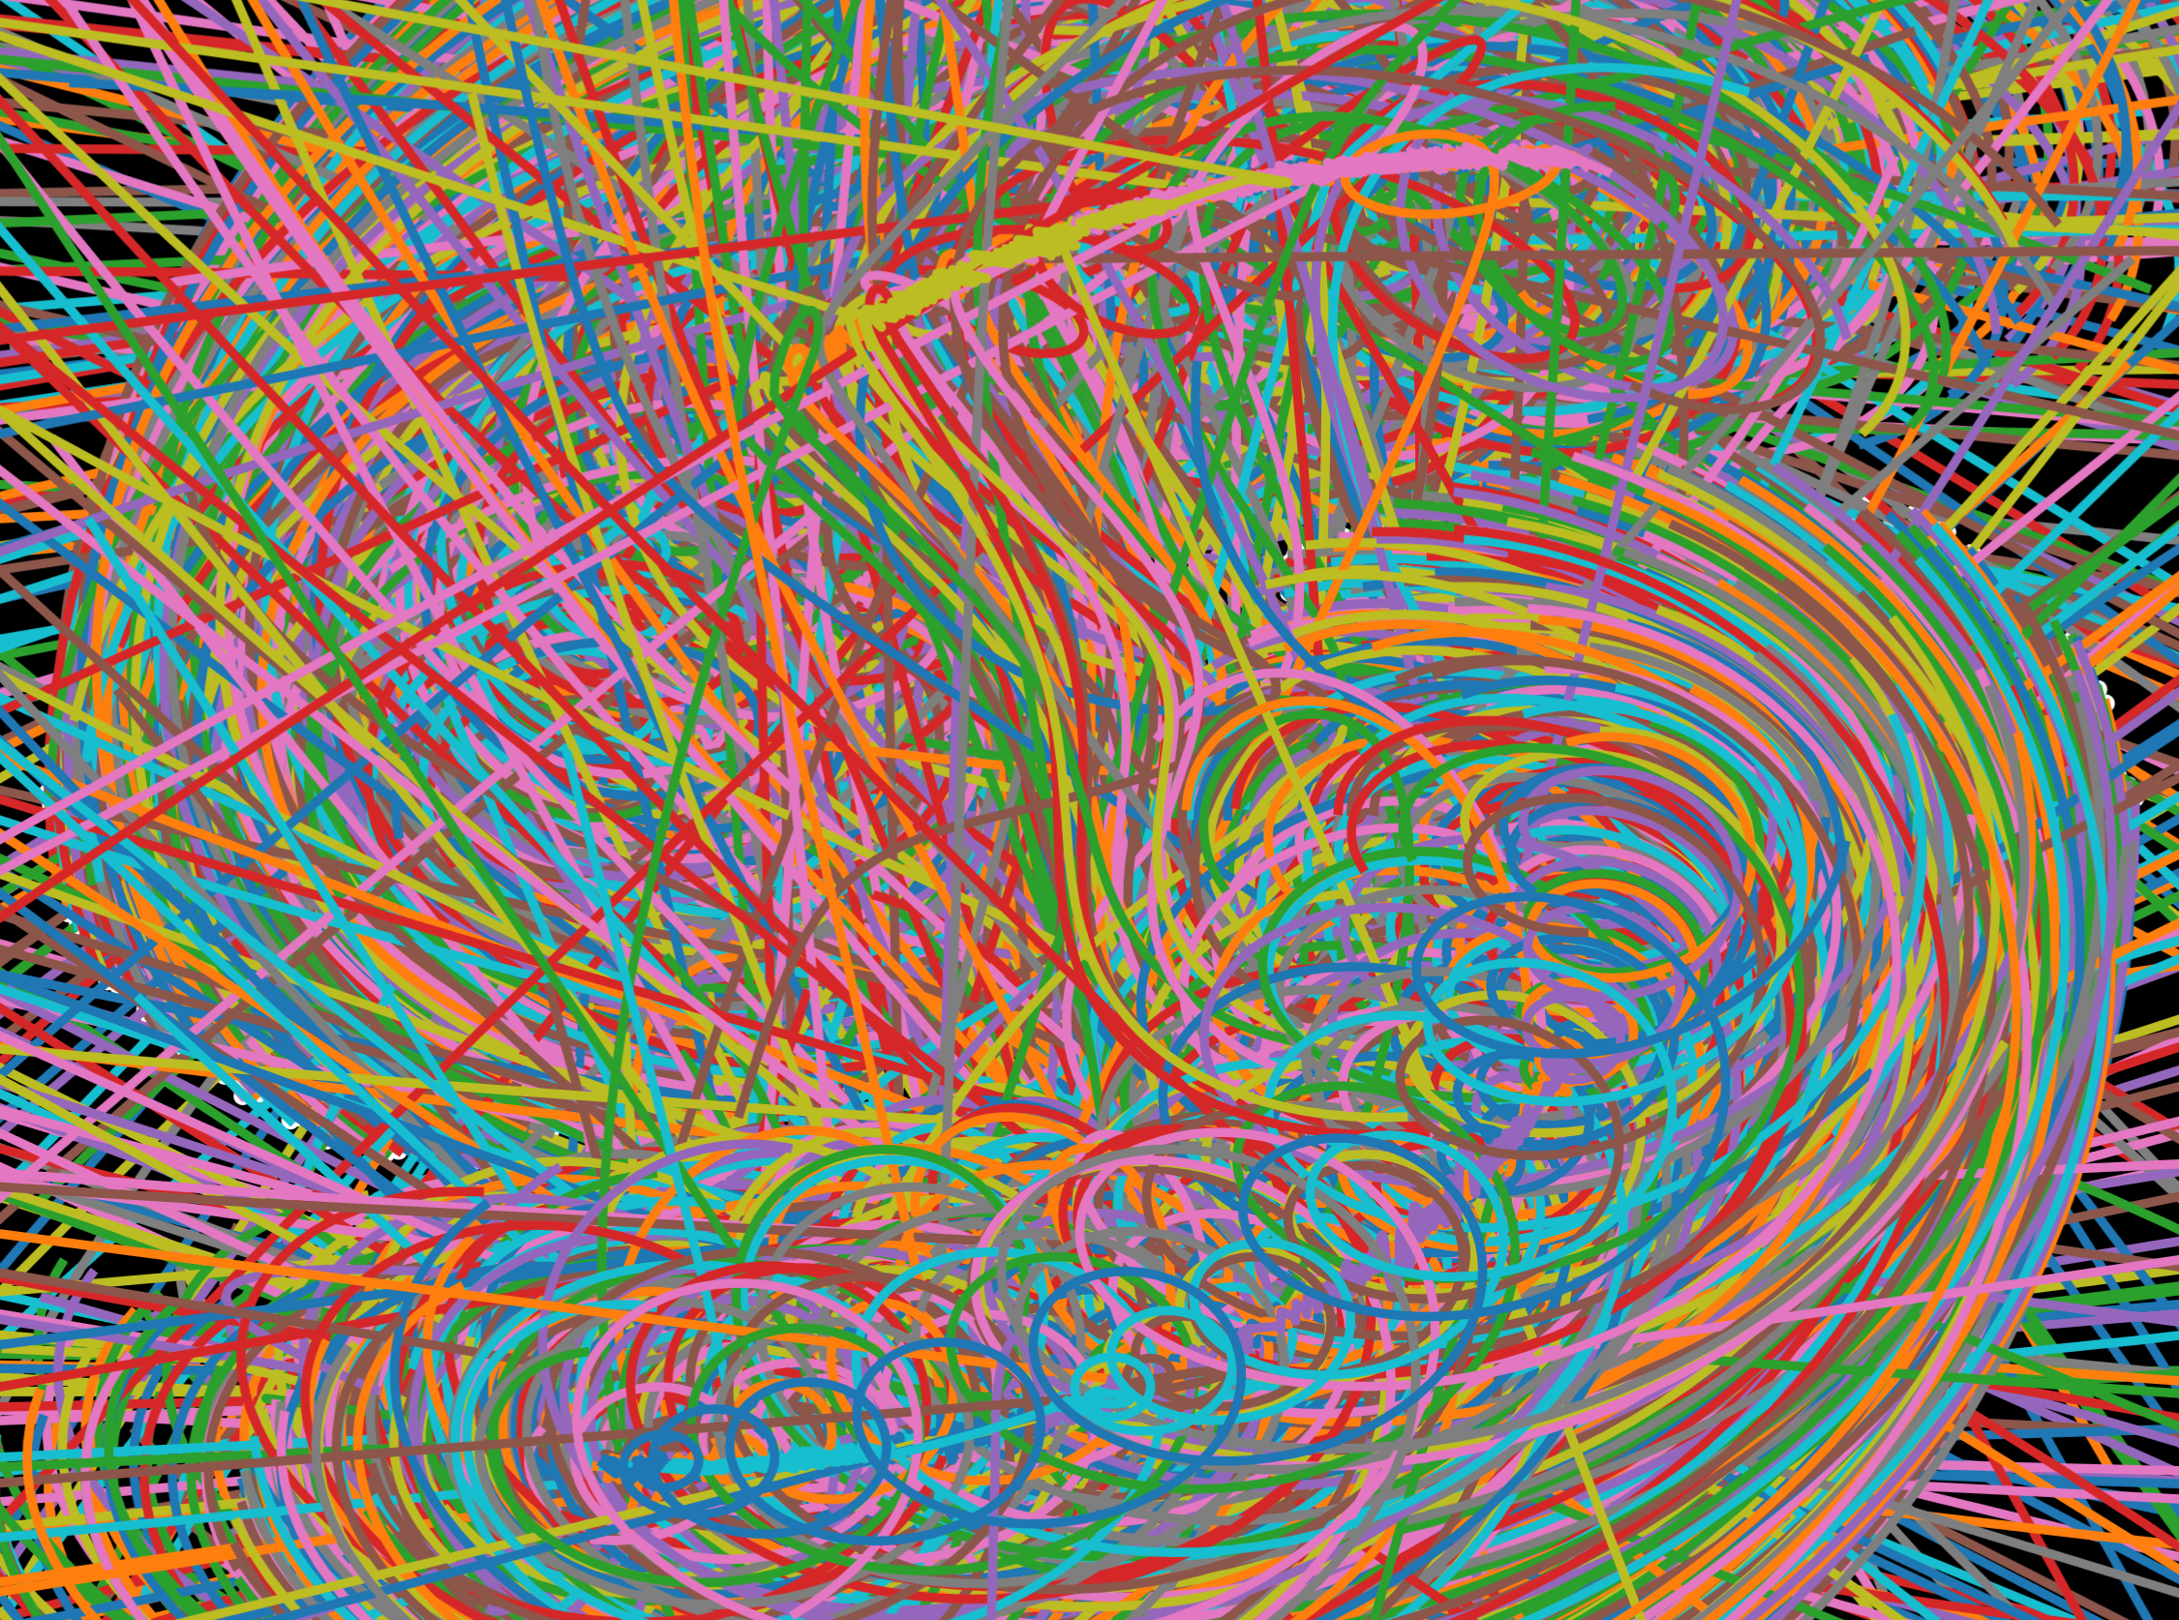
N-Body in Quasilinear Time Barnes-Hut Algorithm
Tim Koreman

Slide 2
N-Body problem
Calculate motion of N bodies.
2 and restricted 3 body problem solved analytically.
Computationally solve bigger problems.
Brute force is in quadratic time, can we do better?

Slide 3
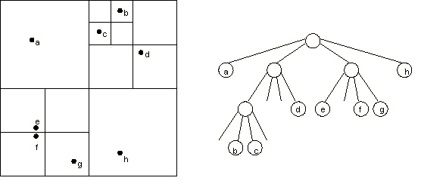
Barnes-Hut Algorithm: Building the tree
Image source: COS 126 – Barnes-Hut Galaxy Simulator - Tom Ventimiglia and Kevin Wayne
http://www.cs.princeton.edu/courses/archive/fall03/cs126/assignments/barnes-hut.html

Slide 4
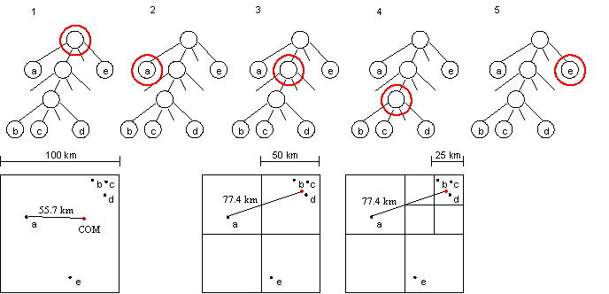
Barnes-Hut Algorithm: Force calculation
Image source: COS 126 – Barnes-Hut Galaxy Simulator - Tom Ventimiglia and Kevin Wayne
http://www.cs.princeton.edu/courses/archive/fall03/cs126/assignments/barnes-hut.html

Slide 5
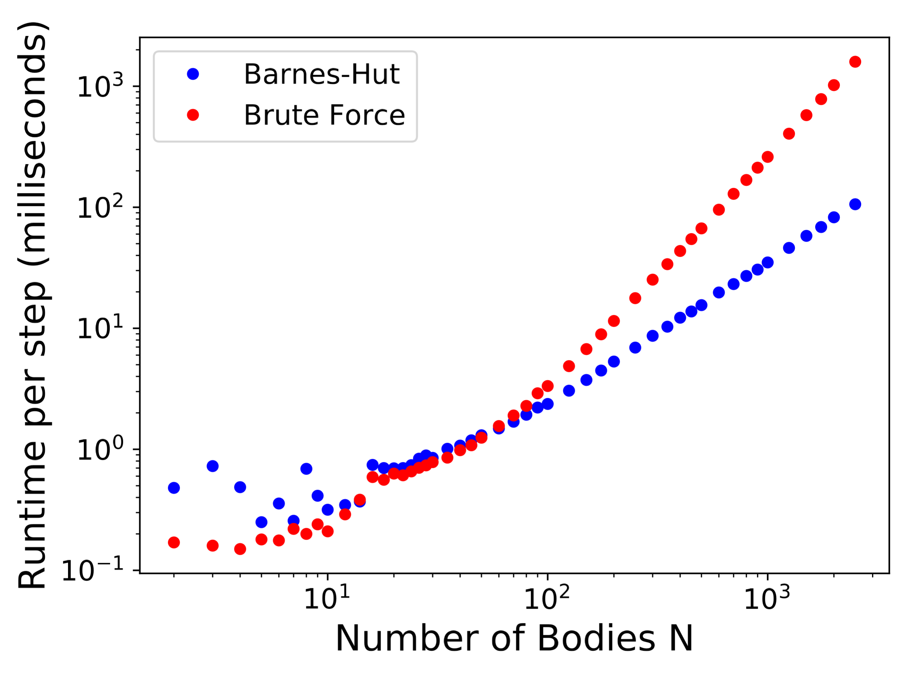
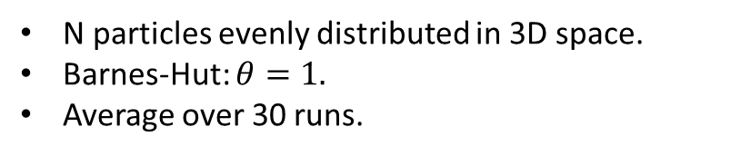
Time Complexity
N particles evenly distributed in 3D space.
Barnes-Hut: $θ=1.$
Average over 30 runs.

Slide 6
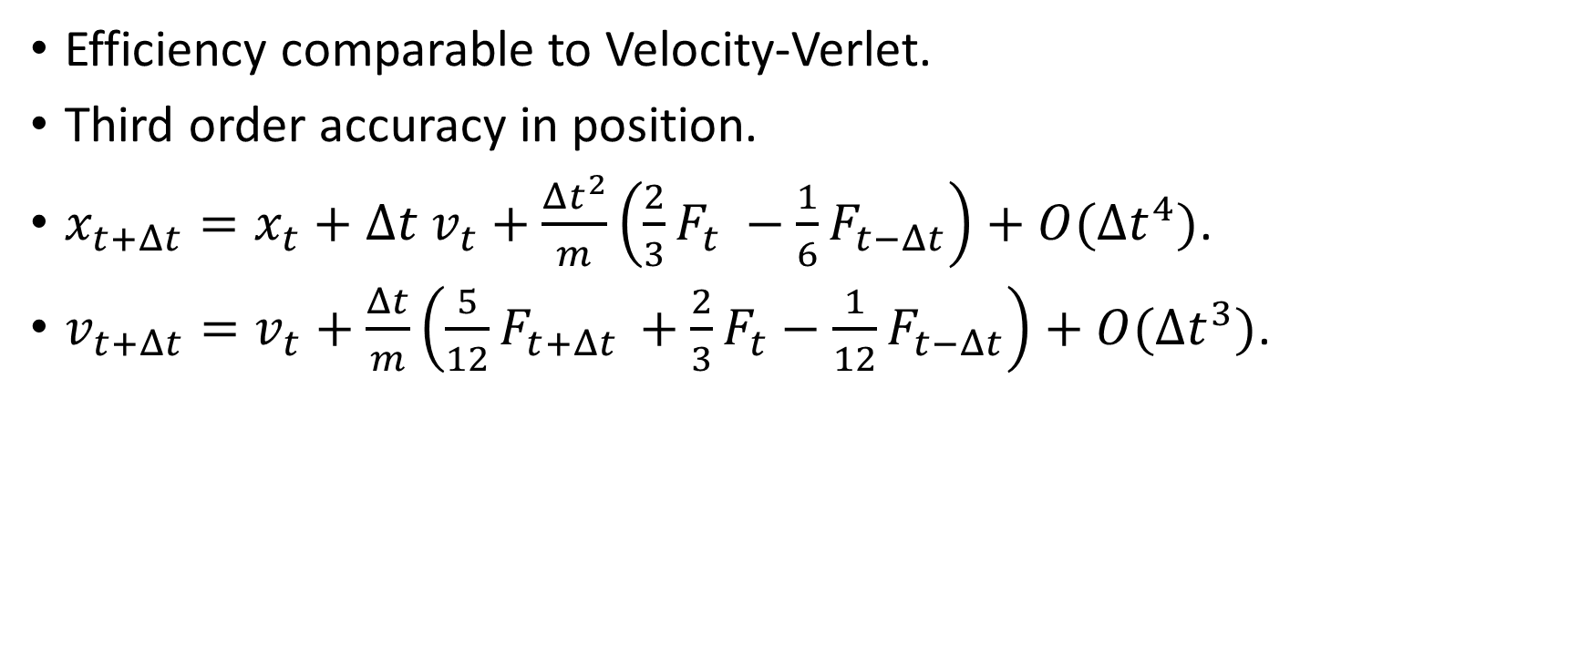
Beeman integration
Efficiency comparable to Velocity-Verlet.
Third order accuracy in position.
$x_{t+Δt}=x_{t}+Δt v_{t}+\frac{Δt^{2}}{m}\left(\frac{2}{3}F_{t} −\frac{1}{6}F_{t−Δt}\right)+O(Δt^{4})$.
$v_{t+Δt}=v_{t}+\frac{Δt}{m}\left(\frac{5}{12}F_{t+Δt }+\frac{2}{3}F_{t}−\frac{1}{12}F_{t−Δt}\right)+O(Δt^{3})$.

Slide 7
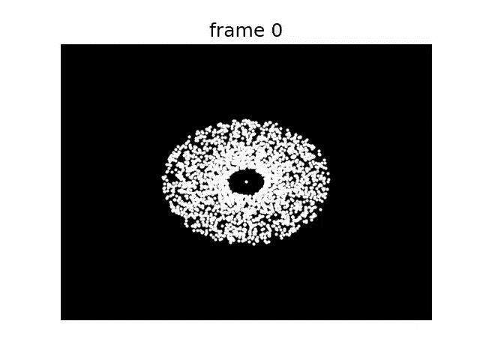
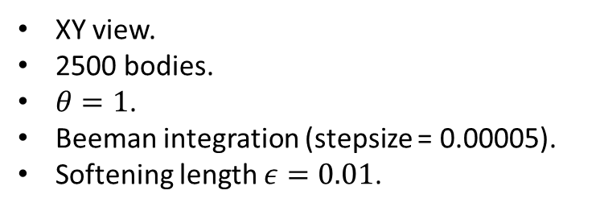
XY view.
2500 bodies.
$θ=1$.
Beeman integration (stepsize = 0.00005).
Softening length $ε=0.01$.

Slide 8
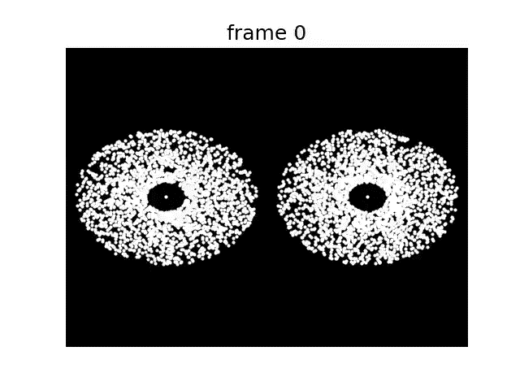
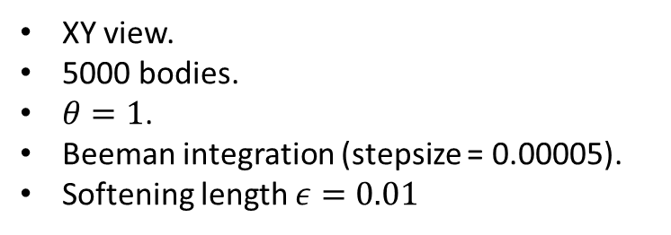
XY view.
5000 bodies.
$θ=1$.
Beeman integration (stepsize = 0.00005).
Softening length $ε=0.01$

Slide 9
Conclusion
BH runs N-body problem in quasilinear time.
Crossover between BH and brute force depends on theta.
Next step: Parallelization.

